Slide 1
US Accidents Analytics
Azure Data Engineering Pipeline
Jainil Malaviya · Rohan Raju · Prasanth Jayabal
DAMG7370 · Northeastern University | April 2026
Azure ADLS Gen2
Databricks PySpark
Azure SQL DB
Power BI
Azure Data Factory

Slide 2
DATASET
US Accidents Dataset
Kaggle — 7.7 Million Rows of Traffic Accident Records
7.73M
46
3 GB
2016–2023
49
Total Records
Columns
Dataset Size
Date Range
US States
Key Columns
State, City, County
Temperature, Weather_Condition
Severity (1–4)
Visibility, Wind_Speed
Start_Time, End_Time
Latitude / Longitude
Source: Kaggle — sobhanmoosavi/us-accidents

Slide 3
PROBLEM STATEMENT
Business Questions We Answer
01
Which US states are the most accident-prone?
02
What time of day and year are accidents most likely to occur?
03
How severe are accidents across different states and conditions?
04
Does weather actually cause more accidents or do people drive worse in good weather?
05
Has road safety in the US improved or worsened over 2016–2023?

Slide 4
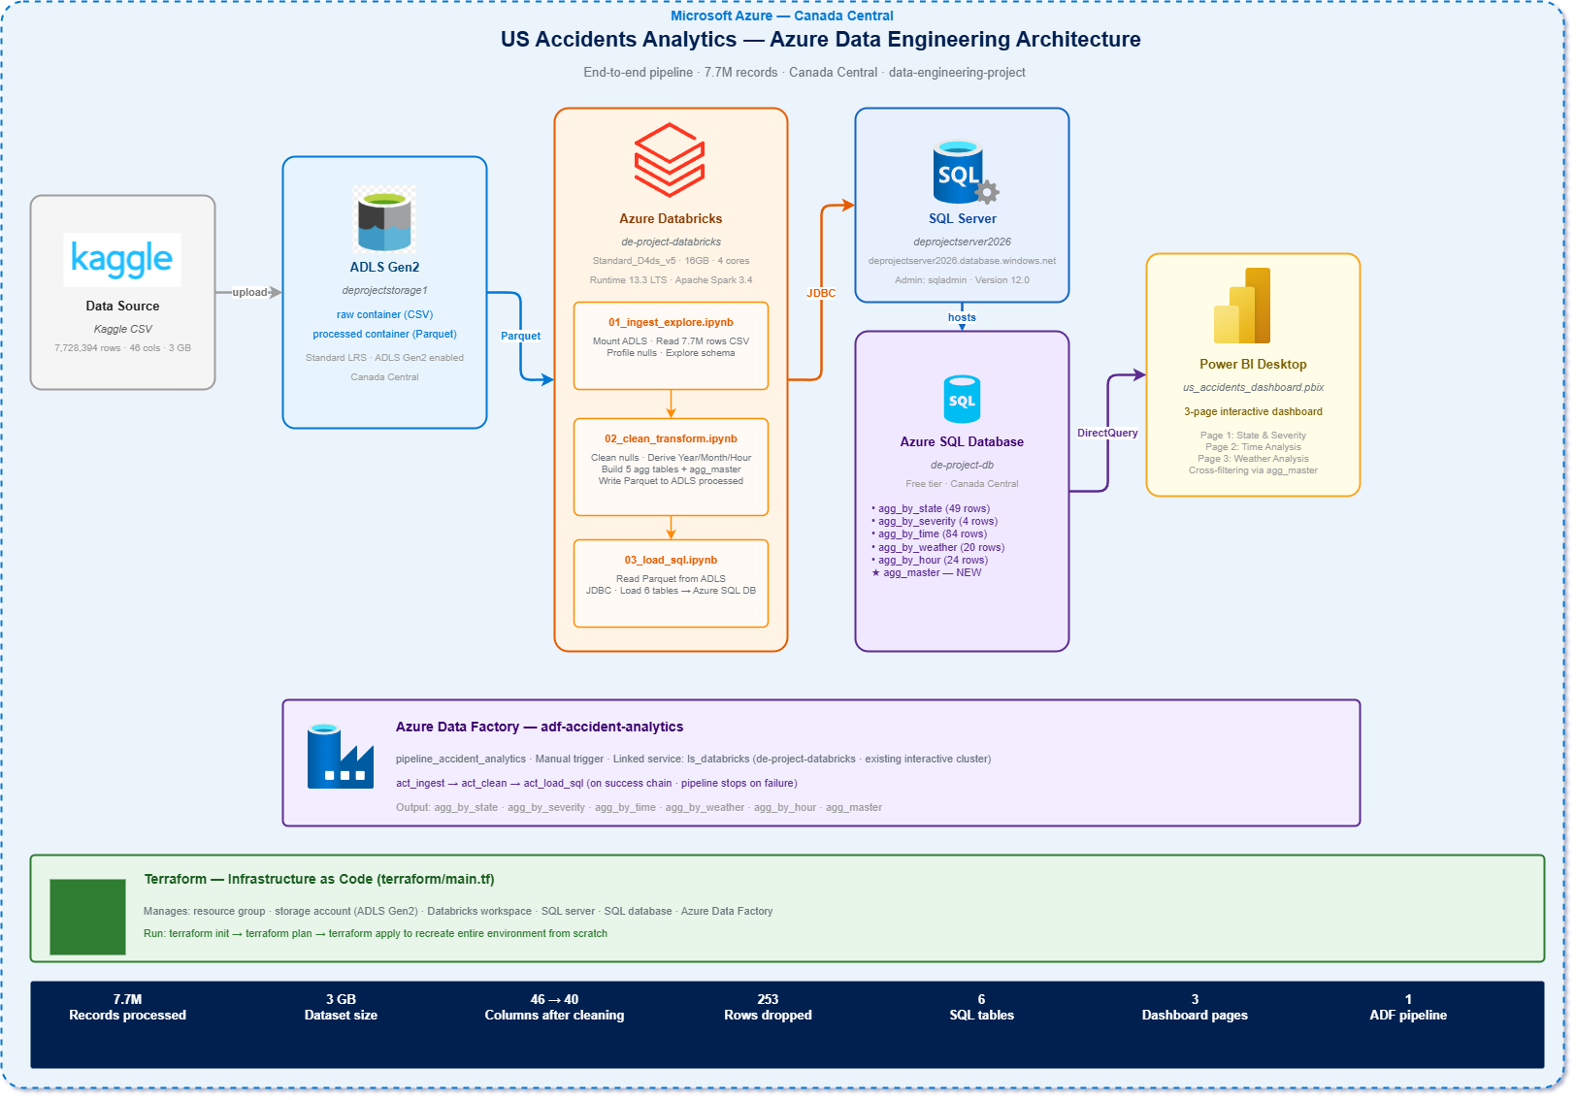
ARCHITECTURE
End-to-End Pipeline Architecture

Slide 5
TECH STACK
Technology Stack & Why Azure
ADLS Gen2
Databricks PySpark
Hierarchical namespace, big data optimized, 10x cheaper than SQL storage
Distributed processing for 7.7M rows; Parquet output 10x compressed vs CSV
Azure Data Factory
Azure SQL Database
Pipeline orchestration with activity chaining; monitors each step
Aggregate tables (max 400K rows); free tier; Power BI native connector
Power BI Desktop
Terraform (IaC)
Interactive cross-filtering; native DirectQuery to Azure SQL
All Azure resources codified; entire environment recreatable in 1 command

Slide 6
INGESTION
Data Ingestion
Kaggle CSV → ADLS Gen2 Raw Container
Provisioned Resource Group in Canada Central
Azure Resources
1
Created Storage Account: deprojectstorage1
(ADLS Gen2, hierarchical namespace enabled)
Resource Group:
data-engineering-project
2
Storage Account:
deprojectstorage1
Created containers: raw/ and processed/
3
Region:
Canada Central
Uploaded US_Accidents_March23.csv (3 GB)
to raw/accidents/ path
Containers:
raw/ + processed/
4
Databricks reads directly from ADLS via
mounted storage account key
File:
US_Accidents_March23.csv
5
Size:
~3 GB | 7,728,394 rows

Slide 7
EXPLORATION
Data Exploration Findings
Notebook: 01_ingest_explore.ipynb
Top Null Columns (Before Cleaning)
Schema Highlights
Column | % Null
End_Lat / End_Lng | 44%
Precipitation (in) | 28%
Wind_Chill (°F) | 25%
Weather_Timestamp | 17%
Wind_Speed (mph) | 13%
46 columns
across 4 categories
Temporal
Start_Time, End_Time, duration
Spatial
Lat/Lng, State, City, Street
Weather
Temp, Humidity, Visibility
Severity
Scale 1 (minor) to 4 (critical)
Key Finding:
Only 253 rows dropped out of 7.73M — a 99.99% data retention rate. High-null columns (End_Lat, Wind_Chill, Precipitation) were dropped entirely rather than imputed.

Slide 8
TRANSFORMATION
Data Cleaning
Notebook: 02_clean_transform.ipynb
BEFORE CLEANING
AFTER CLEANING
7,728,394 rows
46 columns
Null values in 12+ columns
No derived time features
→
7,728,141 rows (99.99% retained)
40 columns (6 dropped)
Medians filled for numerics
+4 derived columns added
Derived Columns Added
Year
Month
Hour
Day_Of_Week
Dropped Columns: End_Lat, End_Lng, Wind_Chill(F), Precipitation(in), Description, Weather_Timestamp

Slide 9
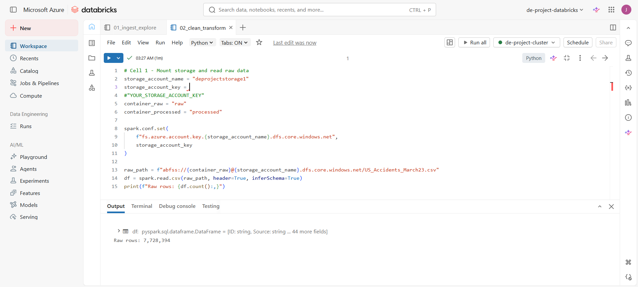
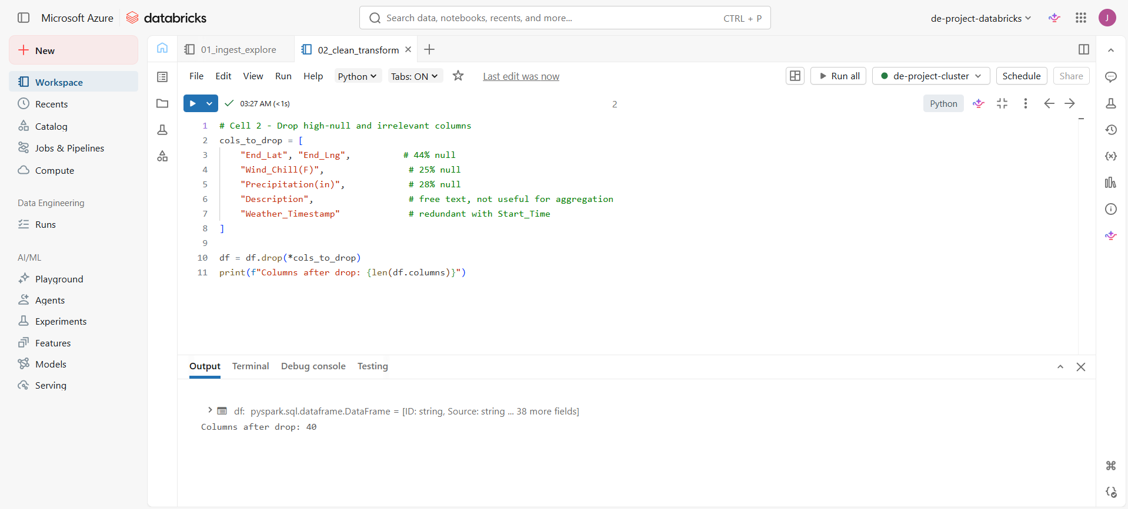
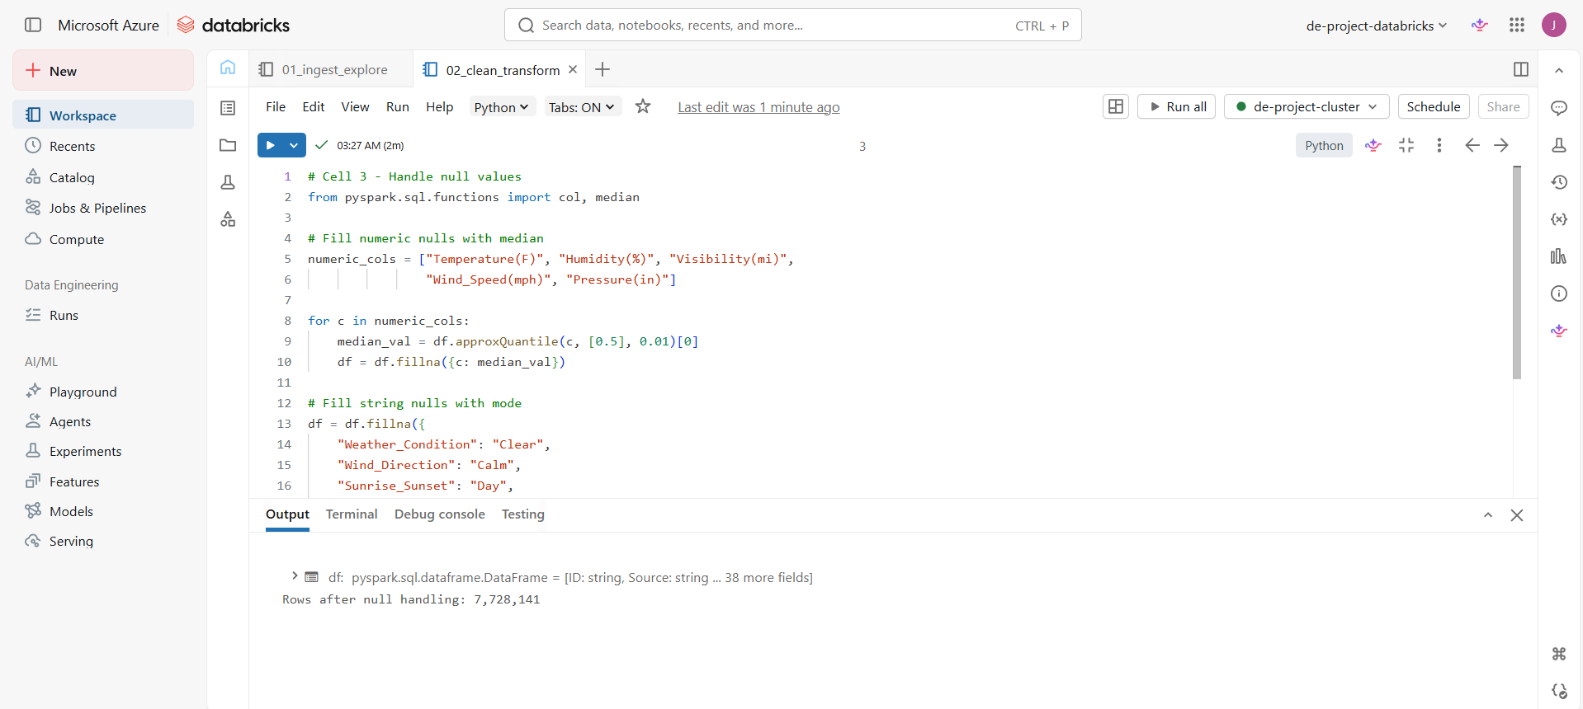
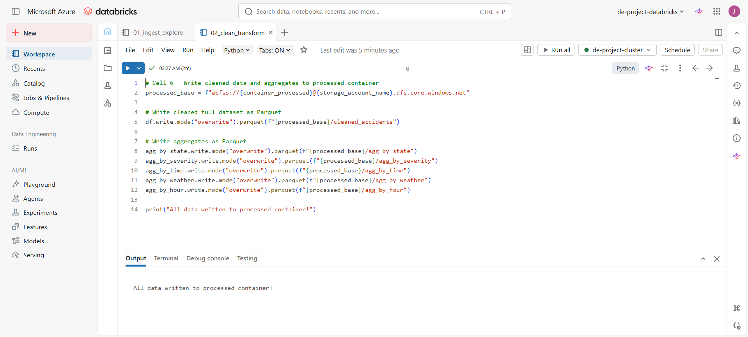
TRANSFORMATION
Data Cleaning

Slide 10
TRANSFORMATION
Aggregation & agg_master Table
6 Aggregate Tables → Power BI-Ready
agg_by_state
agg_by_severity
agg_by_time
49 rows · State, total_accidents, avg_severity
4 rows · Severity level, accident count
~84 rows · Year, Month, accident count
agg_by_weather
agg_by_hour
20 rows · Top 20 conditions, avg severity
24 rows · Hour of day, accident count
⭐ agg_master (~400K rows)
State + Severity + Year + Hour + Weather_Condition + total_accidents
Enables all Power BI slicers to cross-filter simultaneously — standard denormalized fact table pattern

Slide 11
SERVING
Serving Layer
Azure SQL Database — 6 Tables
SQL Server
Database
Region
Auth
deprojectserver2026.database.windows.net
de-project-db (Free Tier)
Canada Central
SQL Admin: sqladmin
Table Name | Rows | Key Columns | Purpose
agg_by_state | 49 | State, total_accidents, avg_severity | Geographic analysis
agg_by_severity | 4 | Severity, count | Severity distribution
agg_by_time | ~84 | Year, Month, accidents | Trend analysis
agg_by_weather | 20 | Weather_Condition, count, avg_severity | Weather impact
agg_by_hour | 24 | Hour, accidents | Time-of-day analysis
agg_master | ~400K | State, Severity, Year, Hour, Weather, total | Power BI cross-filtering

Slide 12
ORCHESTRATION
Azure Data Factory Pipeline
pipeline_accident_analytics — Manual Trigger
Activity 1
Activity 2
Activity 3
act_ingest
act_clean
act_load_sql
01_ingest_explore
On
Success
02_clean_transform
On
Success
03_load_sql
Load CSV → ADLS
Explore schema & stats
Clean nulls, add
derived columns, Parquet
Write 6 aggregate
tables to Azure SQL DB
Configuration Details
Factory:
adf-accident-analytics
Trigger:
Manual (trigger_daily stopped — cost control)
Linked Service:
ls_databricks → de-project-databricks → existing interactive cluster
Cluster:
Standard_D4ds_v5 · 16GB · 4 cores · Runtime 13.3 LTS · Auto-terminate 30 min

Slide 13
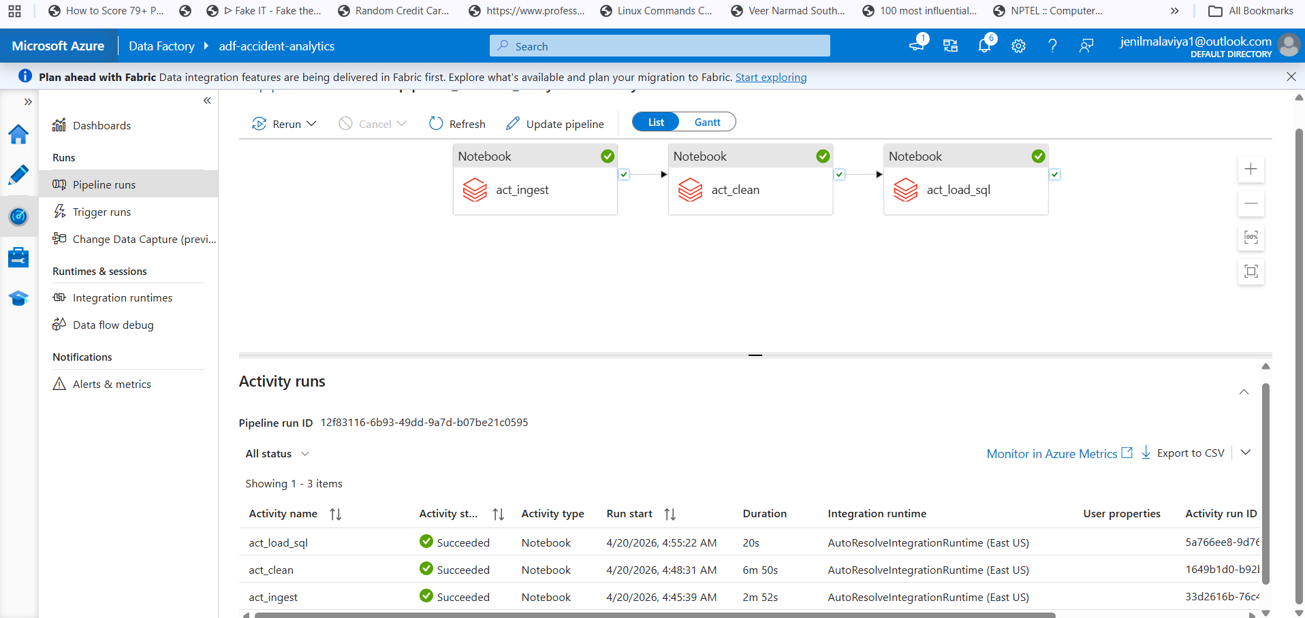
ORCHESTRATION
Azure Data Factory Pipeline

Slide 14
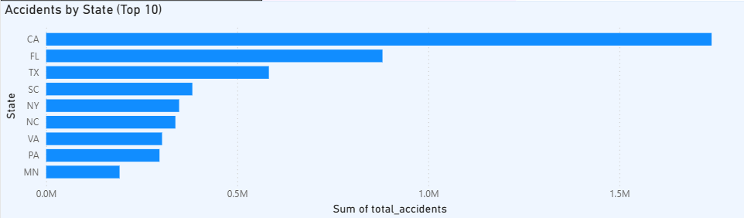
POWER BI
Dashboard Page 1: National Overview
State Rankings & Severity Distribution
7.73M
2.46
49
7 yrs
Total Accidents
Avg Severity
States Covered
Time Span

Slide 15
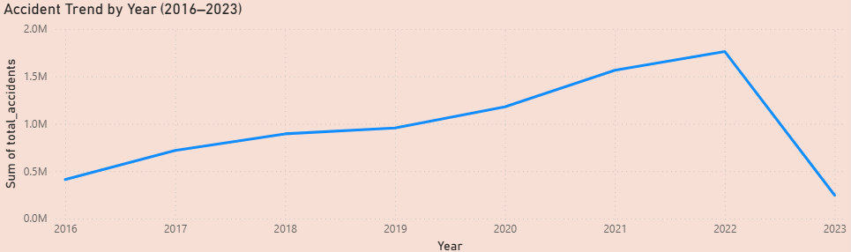
POWER BI
Dashboard Page 2: Time Analysis
Year Trends & Rush Hour Patterns
📈 Accidents grew steadily 2016–2022 (+440%)
📉 2023 drop: dataset ends March 2023 (partial year)
🕗 Peak hours: 7–8 AM and 4–5 PM (rush hour)
🌙 Lowest: 3–4 AM (minimal traffic)

Slide 16
POWER BI
Dashboard Page 3: Weather Analysis
Fair-Weather Paradox & Severity by Condition
☀️ The Fair-Weather
Paradox
Fair weather has 2.5M accidents — the most of any condition.
Why? Drivers over-confident in clear conditions → higher speeds → more accidents. Bad weather causes caution; good weather breeds complacency.
Severity Insight: Snow and fog conditions show HIGHER average severity (2.7–2.9) despite fewer total incidents — rare but more dangerous.

Slide 17
LIVE DEMO
Let's walk through the complete pipeline end-to-end
01
02
03
Infrastructure + Ingestion
Transformation
Serving + Visualization

Slide 18
REFLECTION
Challenges & Learnings
🚧 3 GB CSV — too large for local tools
→
✅ Databricks single-node (16GB RAM) handles it with PySpark effortlessly
🚧 Power BI cross-filtering with 5 separate tables
→
✅ Created agg_master as a denormalized fact table — standard DW pattern
🚧 Azure free tier SQL limitations
→
✅ Aggregating before loading: 400K rows vs 7.7M — sufficient for all BI queries
🚧 ADF scheduler costs on free tier
→
✅ Manual trigger sufficient; production would use daily schedule via trigger_daily
🚧 Secret management in notebooks
→
✅ Placeholder YOUR_STORAGE_ACCOUNT_KEY in Git; regenerate key before every push

Slide 19
FAQ
Why ADLS Gen2 over Blob Storage?
Hierarchical namespace — enables folder-level permissions and is optimized for big data analytics workloads.
Why Parquet over CSV?
Columnar format gives 10x compression and 3x faster reads; ideal for analytical queries on subsets of columns.
Why not load full dataset to SQL?
7.7M rows exceeds free tier; aggregates are sufficient for BI and answer all business questions.

Slide 20
Conclusion & Future Improvements
Key Findings
Future Improvements
California leads with 1.74M accidents (22% of all US)
Medallion architecture (Bronze/Silver/Gold)
79% of accidents are Severity 2 — moderate impact
Real-time streaming via Azure Event Hubs
Rush hours (7–8 AM, 4–5 PM) are peak danger windows
ML model: accident severity prediction
Fair weather paradox: clear skies = most accidents
Azure DevOps CI/CD for notebook deployment
Accident count grew 440% from 2016 to 2022
Scheduled ADF trigger for daily refresh
Thank You — Questions?
Jainil Malaviya · Rohan Raju · Prashanth Jayabal | GitHub: jainil2111/azure-accident-analytics

